Slide 1
Bezier Curve Numericals
-by Sakshi Jha

Slide 2
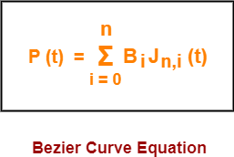
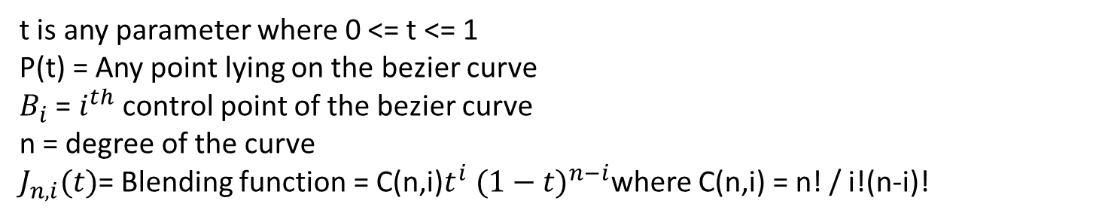
t is any parameter where 0 <= t <= 1
P(t) = Any point lying on the bezier curve
$B_{i}$ = $i^{th}$ control point of the bezier curve
n = degree of the curve
$J_{n,i}(t)$= Blending function = C(n,i)$t^{i} {(1−t)}^{n−i}$where C(n,i) = n! / i!(n-i)!

Slide 3


Degree = Number of Control Points – 1
Substituting n = 3 for a cubic bezier curve, we get-
Expanding the above equation, we get-

Slide 4
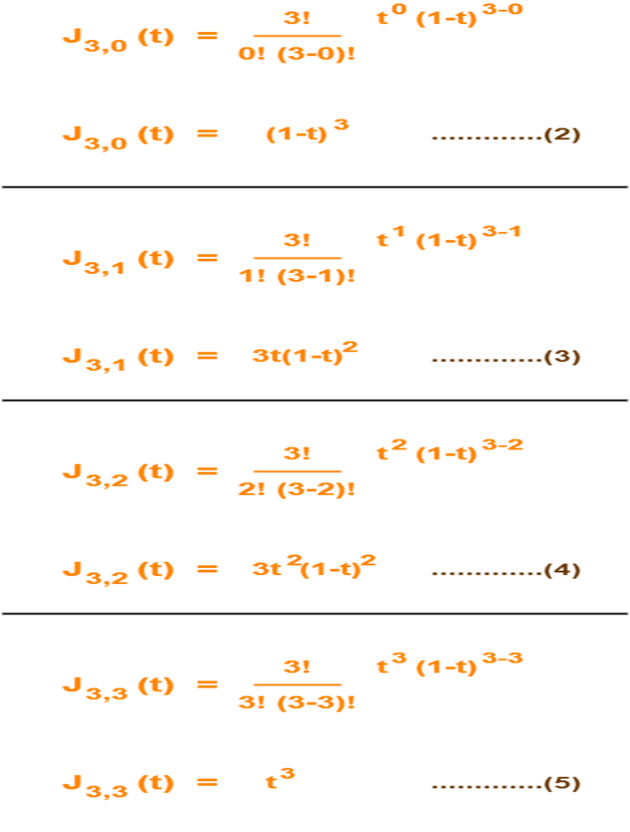

Using (2), (3), (4) and (5) in (1), we get-
Parametric equation for a cubic bezier curve.

Slide 5
Given a bezier curve with 4 control points- B₀[1 0] , B₁[3 3] , B₂[6 3] , B₃[8 1] Determine any 5 points lying on the curve. Also, draw a rough sketch of the curve.
Solution : Control Points =4
Degree = 4-1 = 3
It means ,its Cubic Bezier Curve. Parametric Equation for Bezier Curve is :-
Substitute the values of control points,
P(t) = [1 0](1-t)³ + [3 3]3t(1-t)² + [6 3]3t²(1-t) + [8 1]t³ ……..(1)
To get 5 points lying on the curve, assume any 5 values of t lying in the range 0 <= t <= 1.
Let 5 values of t are 0, 0.2, 0.5, 0.7, 1
Given Control Points
Assume values of equal intervals/difference

Slide 6
For t = 0:
Substituting t=0 in (1), we get-
P(0) = [1 0](1-0)³ + [3 3]3(0)(1-t)² + [6 3]3(0)²(1-0) + [8 1](0)³
P(0) = [1 0] + 0 + 0 + 0
P(0) = [1 0]
For t = 0.2:
Substituting t=0.2 in (1), we get-
P(0.2) = [1 0](1-0.2)³ + [3 3]3(0.2)(1-0.2)² + [6 3]3(0.2)²(1-0.2) + [8 1](0.2)³
P(0.2) = [1 0](0.8)³ + [3 3]3(0.2)(0.8)² + [6 3]3(0.2)²(0.8) + [8 1](0.2)³
P(0.2) = [1 0] x 0.512 + [3 3] x 3 x 0.2 x 0.64 + [6 3] x 3 x 0.04 x 0.8 + [8 1] x 0.008
P(0.2) = [1 0] x 0.512 + [3 3] x 0.384 + [6 3] x 0.096 + [8 1] x 0.008
P(0.2) = [0.512 0] + [1.152 1.152] + [0.576 0.288] + [0.064 0.008]
P(0.2) = [2.304 1.448]

Slide 7
For t = 0.5:
Substituting t=0.5 in (1), we get-
P(0.5) = [1 0](1-0.5)³ + [3 3]3(0.5)(1-0.5)² + [6 3]3(0.5)²(1-0.5) + [8 1](0.5)³
P(0.5) = [1 0](0.5)³ + [3 3]3(0.5)(0.5)² + [6 3]3(0.5)²(0.5) + [8 1](0.5)³
P(0.5) = [1 0] x 0.125 + [3 3] x 3 x 0.5 x 0.25 + [6 3] x 3 x 0.25 x 0.5 + [8 1] x 0.125
P(0.5) = [1 0] x 0.125 + [3 3] x 0.375 + [6 3] x 0.375 + [8 1] x 0.125
P(0.5) = [0.125 0] + [1.125 1.125] + [2.25 1.125] + [1 0.125]
P(0.5) = [4.5 2.375]
For t = 0.7:
Substituting t=0.7 in (1), we get-
P(t) = [1 0](1-t)³ + [3 3]3t(1-t)² + [6 3]3t²(1-t) + [8 1]t³
P(0.7) = [1 0](1-0.7)³ + [3 3]3(0.7)(1-0.7)² + [6 3]3(0.7)²(1-0.7) + [8 1](0.7)³
P(0.7) = [1 0](0.3)³ + [3 3]3(0.7)(0.3)² + [6 3]3(0.7)²(0.3) + [8 1](0.7)³
P(0.7) = [1 0] x 0.027 + [3 3] x 3 x 0.7 x 0.09 + [6 3] x 3 x 0.49 x 0.3 + [8 1] x 0.343
P(0.7) = [1 0] x 0.027 + [3 3] x 0.189 + [6 3] x 0.441 + [8 1] x 0.343
P(0.7) = [0.027 0] + [0.567 0.567] + [2.646 1.323] + [2.744 0.343]
P(0.7) = [5.984 2.233]

Slide 8
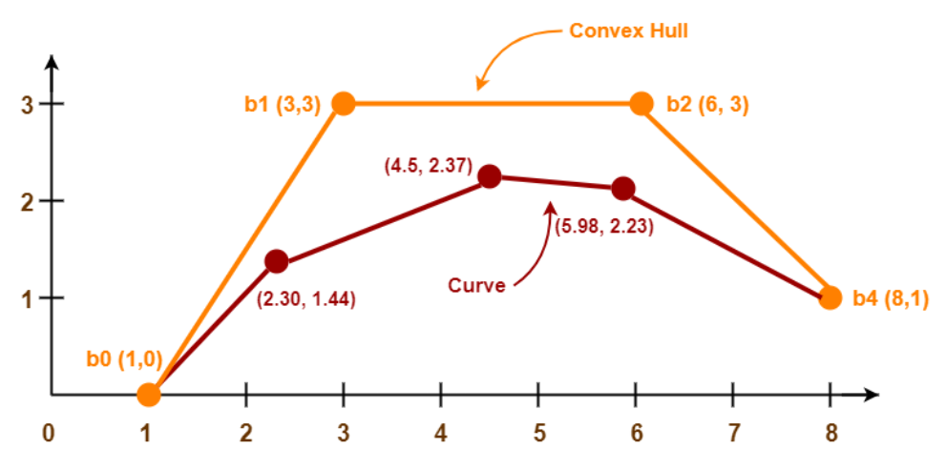
For t = 1:
Substituting t=1 in (1), we get-
P(1) = [1 0](1-1)³ + [3 3]3(1)(1-1)² + [6 3]3(1)²(1-1) + [8 1](1)³
P(1) = [1 0] x 0 + [3 3] x 3 x 1 x 0 + [6 3] x 3 x 1 x 0 + [8 1] x 1
P(1) = 0 + 0 + 0 + [8 1]
P(1) = [8 1]
Following is the required rough sketch of the curve-
Convex Hull property for a Bezier curve ensures that the polynomial smoothly follows the control points

Slide 9
Construct the Bezier curve of order 3 and with polygon vertices A(1,1),B(2,3),C(4,3) and D(6,4).

